Slide 1

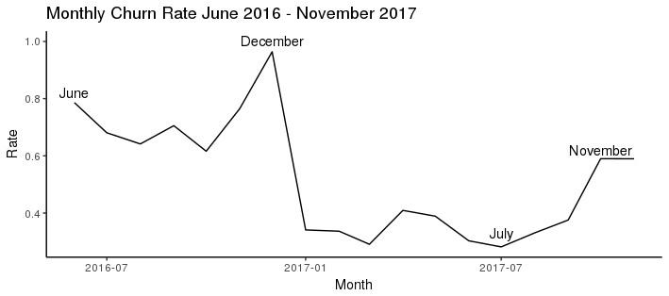
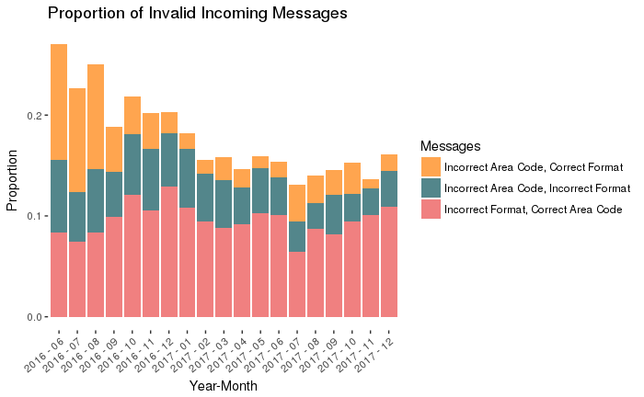
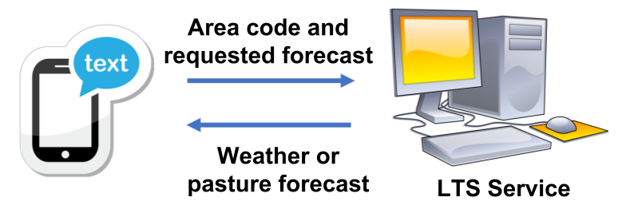
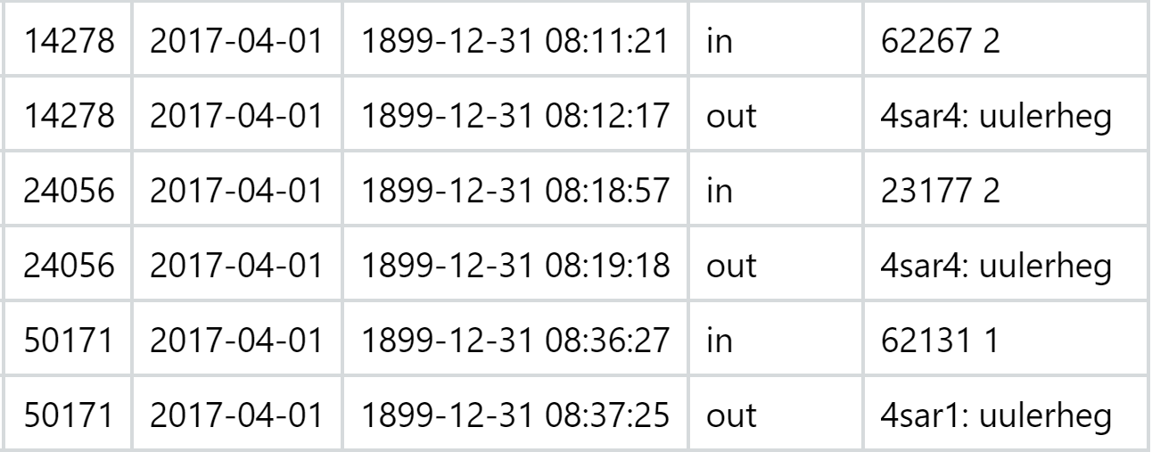
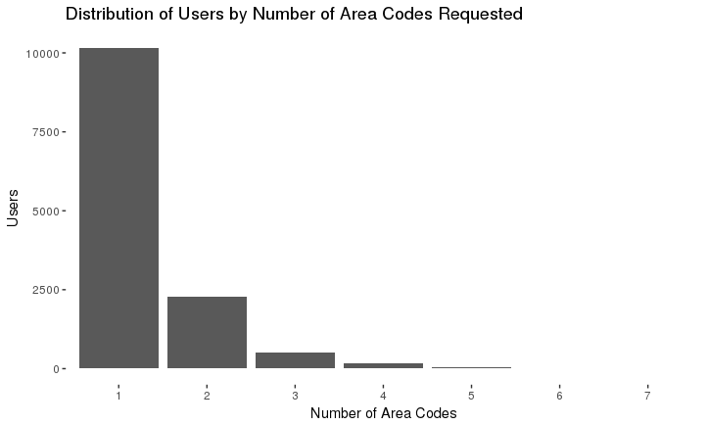
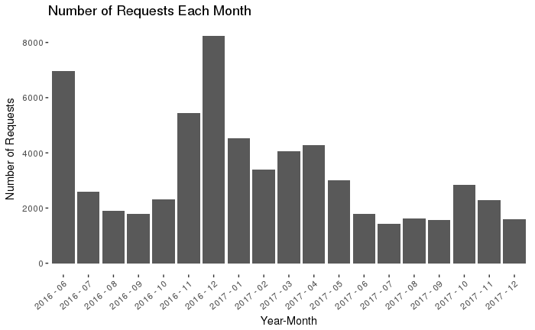
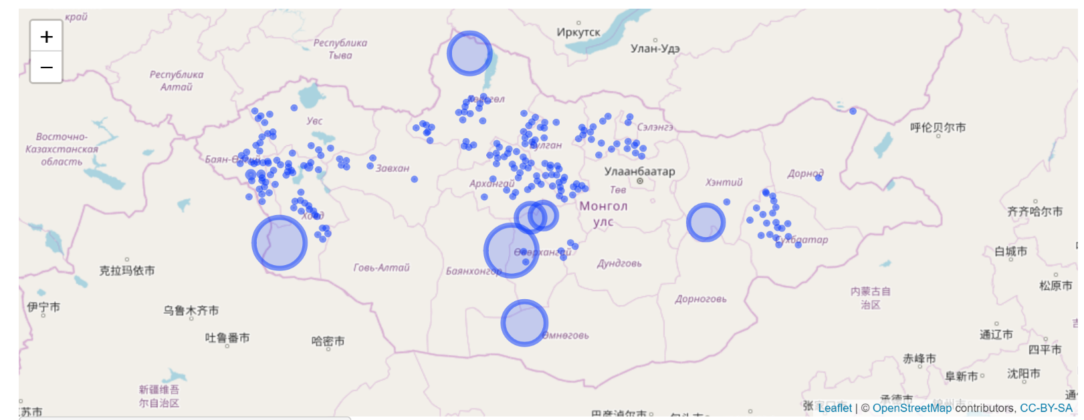
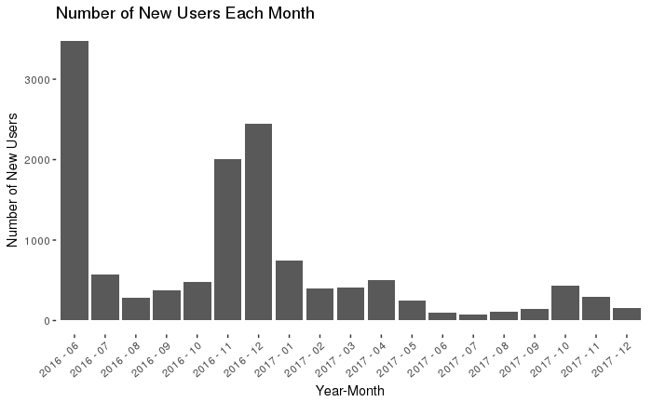
Usage patterns of the LTS-2 SMS System
Giovanni Corti, Wenxin Du, Ilana Heaton
The LTS-2 System
User Errors
Churn Rate
The LTS-2 is an SMS information system designed to help Mongolian nomadic herders improve livestock outcomes. The system works by providing weather forecast and pasture information to herders through text message. One to three and four to six day weather forecasts are available in addition to pasture forage information from the Livestock Early Warning System (LEWS).
Users commonly send in requests that are either incorrectly formatted or request information for area codes that do not exist. As Figure 2 shows, between 15%-25% of messages are invalid. Invalid messages receive no responses.
The LTS-2 system is not comprised of a constant user base. Instead new users are frequently joining and existing users are stopping use of the system.
The flux of the user base can be quantified by calculating the churn rate. Churn rate is defined as the proportion of people who use the system for the last time in a given month. It should be noted that users are tracked by phone number so a user who changes phone numbers will appear as having dropped out of the system. This may help explain the extremely high churn rate in December of 2016.
Figure 1. A schematic of the LTS-2 system
The Data
Figure 4. Churn rate of the system calculated on a monthly basis.
The data is comprised of incoming and outgoing messages and contains approximately 125,000 observations. Telephone numbers have been replaced with random unique identifiers in order to protect the privacy of individual users
Figure 2. The proportion of invalid messages each moth along with the cause of the error.
Use over time
Spatial Distribution of Use
The LTS-2 system exhibits an expected seasonal cycle and its winter usage seems to be decreasing. Use of the system spiked during November and December of 2016 but similar spikes in usage did not occur during the winter of 2017. However, the system saw a fairly consistent number of requests during the summers of 2016 and 2017.
As Figure 5 shows, most users only request forecasts for one or two area codes. This seems to indicate that most users of the LTS-2 system are herding livestock in a fairly small area.
Table 1. A small subset of the raw data. Phone numbers have been changed to random unique identifiers.
Shiny App
We constructed an web based interactive map that allows users to visualize the spatial distribution of forecast requests. The app allows for the users to specify a time interval during which the requests occurred along with the type of forecast requested. The app can be found at URL.
Figure 5. Distribution of users by the number of areas they request forecasts for.
Figure 3. The total number of requests received by the LTS-2 system
Figure 2. A screenshot of the interactive web map. The size of the circles corresponds to the number of requests from a particular area.
Conclusion
We examine user behavior and analyze the spatial and temporal usage of the LTS-2 system. We find a strong spike in usage during the winter of 2016 that is not repeated in winter 2017. We also find that many users have trouble sending correctly formatted messages and that there is a very high churn rate among users. These two factors may be correlated. We suggest responding to incorrectly formatted requests with an error message that contains details on how to correctly format a request. Finally a shiny app is accessible at URL to allow for interactive visualization of the spatial distribution of requests.

